Slide 1
DiGiTaL Digital Games Treasury and Library
Project Number :
2021-1-ES01-KA220-SCH-000032557
Project total duration : 24 Months

Slide 2
Erasmus+
KA220-SCH - Cooperation partnerships in school education

Slide 3
The application for this project was made to the Spanish National Agency by the IES Javier García Téllez and the project was funded by the European Union.

Slide 4
project total budget: 160.260 EURO

Slide 5
PROJECT
PARTNER
COUNTRIES
Spain
Portugal
Macedonia
Turkey
Romania
Croatia

Slide 6
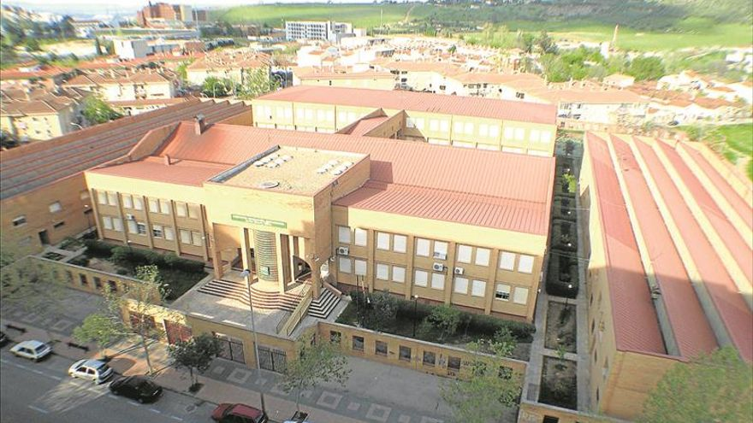
IES Javier García Téllez-
SPAIN
Coordinator school

Slide 7
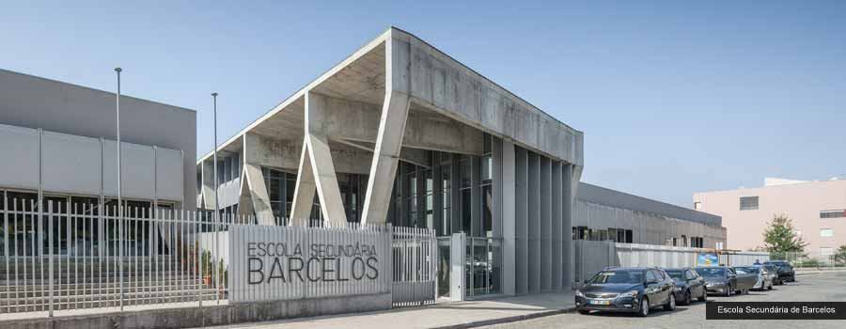
Agrupamento De Escolas De Barcelos-
PORTUGAL
Partner School

Slide 8
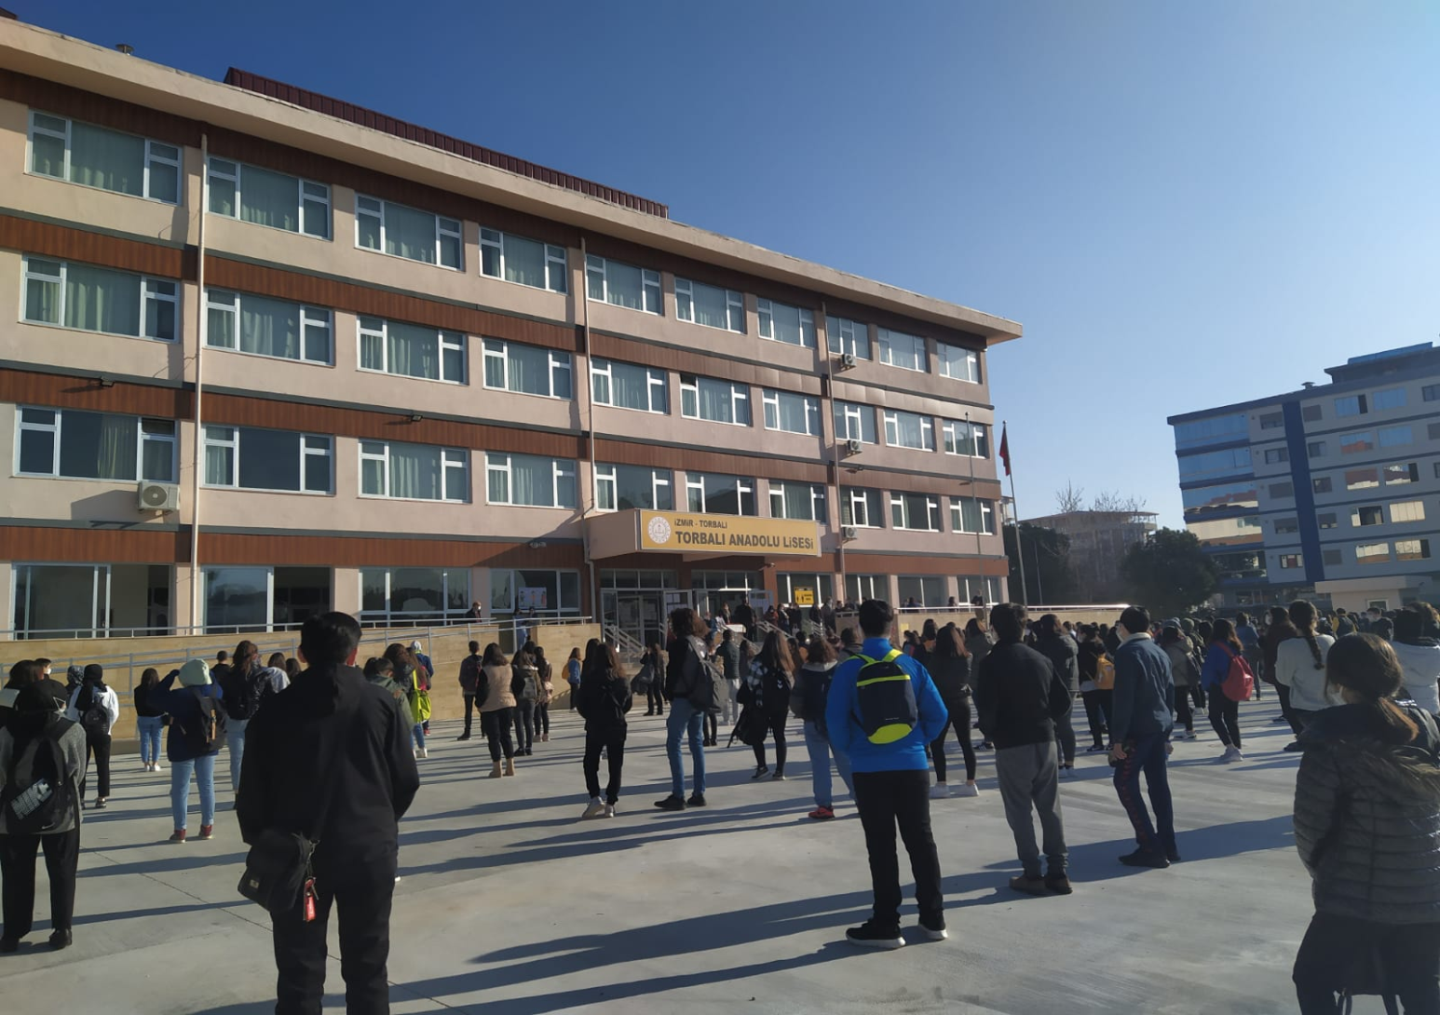
Torbalı Anadolu Lisesi
TURKEY
Partner School

Slide 9
ASSOCIAÇÃO TERRAS LUSAS-MOVIMENTOS EUROPEUS-
PORTUGAL
Partner NGO

Slide 10
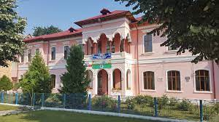
Colegiul Tehnic "Petru Poni" ROMANIA
Partner School

Slide 11
Association Scientia Nova Kavadarci-
MACEDONIA
Partner NGO

Slide 12
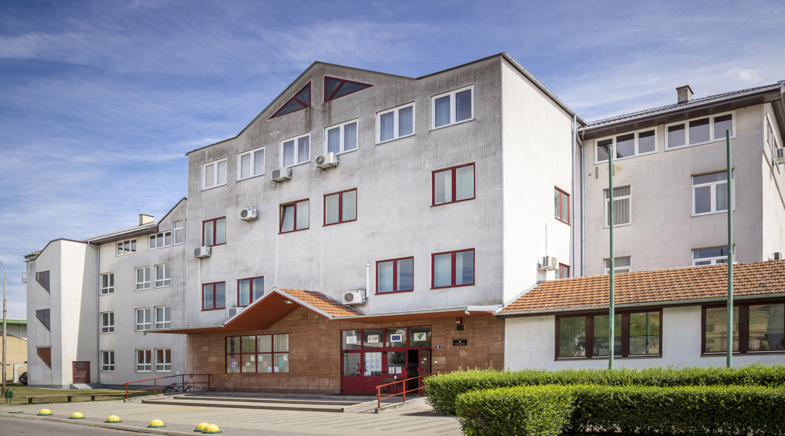
Srednja skola Valpovo-
CROATIA
Partner School

Slide 13
Project Objectives: 1
Ensure digital transformation and adding an attribution to the education that was largely affected by Covid-19 Epidemic.

Slide 14
Project Objectives: 2
Improve our teachers' ICT abilities that are necessary for the digital education.
Support teachers'/ educators' teaching profiles in digital education.

Slide 15
Project Objectives: 3
Introduce teachers with web 2 tools to give opportunities them to prepare their own digital course contents.

Slide 16
Project Objectives: 4
Prepare some useful and enjoyable digital course materials that all the teachers and students in Europe can use during in flipped, virtual or blended
learning in real classrooms or during individual online study.

Slide 17
Project Objectives: 5
Design digital educational games as useful and enjoyable course materials to practice some common courses taught in Europe such as English Language, Maths, Natural Sciences, Philosophy and Art.

Slide 18
Project Objectives:6 (Intellectual Output)
Produce a digital game library as a course material that has an open/free website site as an Open Educational Resource (OER).

Slide 19
MOBILITIES OF THE PROJECT
In this project there will be;
* 5 TPMs (Transnational Project Meeting)
(2 Participants in each TPM)
* 3 LTTAs (Learning Teaching Training Activity)
(3 Participants in each LTT)

Slide 20
TPMs and LTTAs
TPM-1 Croatia (Kick-Off Meeting)
TPM-2 Turkey (Planning of Intellectual Output)
TPM-3 Macedonia (Monitoring IO’s ongoing process)
TPM-4 Portugal (Evaluation of Intellectual Output)
TPM-5 Romania (Project Evaluation Meeting) (comparing objectives and results)
LTT-1 Spain : Education: Web 2.0 Tools in education
LTT-2 Makedonia: Workshop: Gamification Implementations
LTT-3 Portugal: Education: Digital Content Development

Slide 21
Project Intellectual Output
Digital Games Treasury and Library
We aim to produce 10 Digital Educational games in the courses of;
English Language
Maths
Natural Sciences
Philosophy
Art
We will produce 2 course contents which are useful and enjoyable for each course. We will produce an open/free access Digital Games Library Website (OER) as a substantial Project Result.

Slide 22
DISSEMINATION
All the project activities and resutls will be shared through these platforms below:
Workshops:After each LTTA there will be local workshops for the partner school staff.
Bill-boards: Activities and results of the project will be shared monthly on the school billboards.
Project website: All the activities, results and audio-visual materials of the project will be uploaded on the project website.
Erasmus+ Days: Every partner will attend to the Erasmus+ Days in their countries and share the project.
Seminars: Each partner will share the project with the local schools.
Social media accounts: They will be used to share project results with wider public.
Local press: They wil be used to share project results locally.

Slide 23
Please click on these Platforms to learn more about << Digital Games Treasury and Library (DiGiTaL) >>
https://digital2022.wixsite.com/digital
facebook.com/digitalproject2021
Instagram.com/2021DiGiTaLProject
Twitter.com/2021DiGiTaL
https://www.youtube.com/channel/UCBAhfQ74Ytyj2rlkvksEd2A

Slide 24
THANKS FOR YOUR ATTENDANCE

